Slide 1
Machine Learning - Introduction
Data Science

Slide 2
Structured Data (1)
can be stored in as tables (or matrices)
have a defined interpretation for each column (or limited group of columns)
can be evaluated (queried) as tables
Structured data can be stored and analyzed
in relational database tables

Slide 3
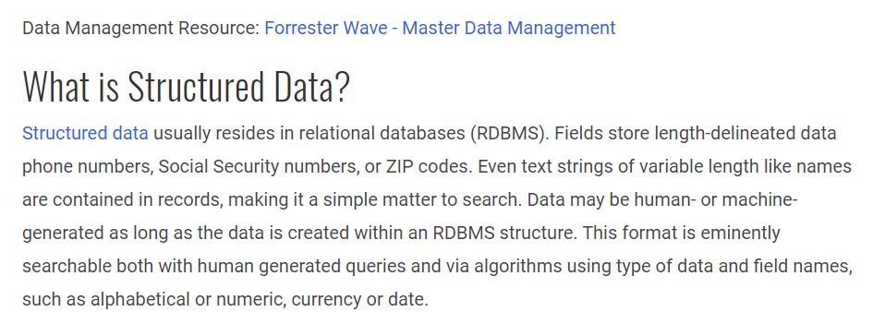
Structured Data (2)
https://www.datamation.com/big-data/structured-vs-unstructured-data.html

Slide 4
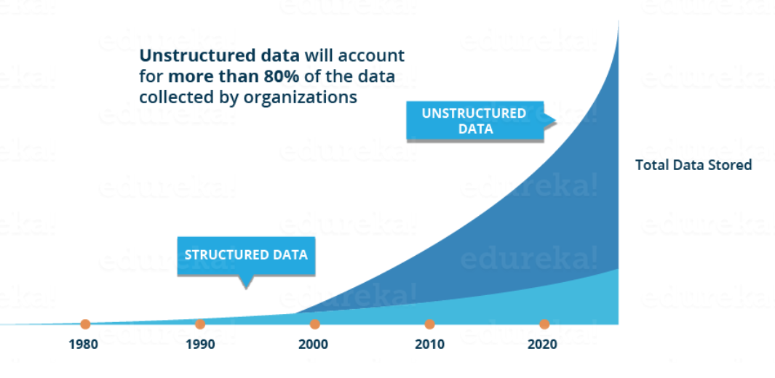
Structured and Unstructured Data More than 80% of data will be unstructured by 2020
Source: https://www.edureka.co/blog/what-is-data-science/

Slide 5
Definition „Data Science“
Data science is a multi-disciplinary field that uses scientific methods, processes, algorithms and systems to extract knowledge and insights from structured and unstructured data. Data science is the same concept as data mining and big data: "use the most powerful hardware, the most powerful programming systems, and the most efficient algorithms to solve problems".
Data science is a "concept to unify statistics, data analysis, machine learning and their related methods" in order to "understand and analyze actual phenomena" with data. It employs techniques and theories drawn from many fields within the context of mathematics, statistics, computer science, and information science.
Basierend auf: https://en.wikipedia.org/wiki/Data_science

Slide 6
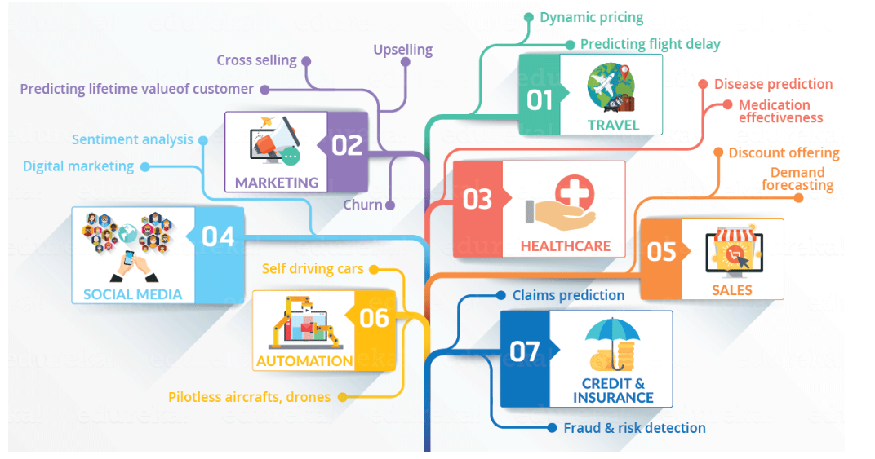
Use Cases for Data Science
Source: https://www.edureka.co/blog/what-is-data-science/

Slide 7
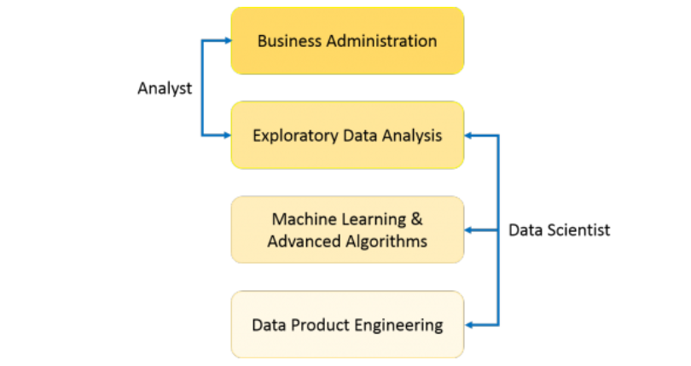
Data Analyst vs. Data Scientist Explain vs Predict/Decide
Explain
what we
know
Predict and decide based on what we know
In statistics, exploratory data analysis is an approach to analyzing data sets to summarize their main characteristics, often with visual methods.
Source: https://www.edureka.co/blog/what-is-data-science/

Slide 8
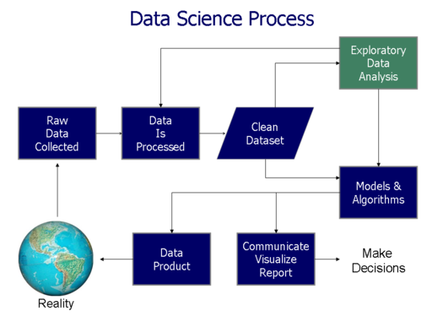
Data Science Process
https://www.kdnuggets.com/2016/03/data-science-process.html

Slide 9
Lesestoff
https://blog.iao.fraunhofer.de/data-science-und-kuenstliche-intelligenz-wie-ihre-daten-das-kundenverhalten-vorhersagbar-machen/

